Slide 1
Digital Marketing Analysis
Marcos Castillo
2/28/2022

Slide 2
Agenda
Industry Problem
Why is it Important to the industry?
Methods
Results. (include visualizations)

Slide 3
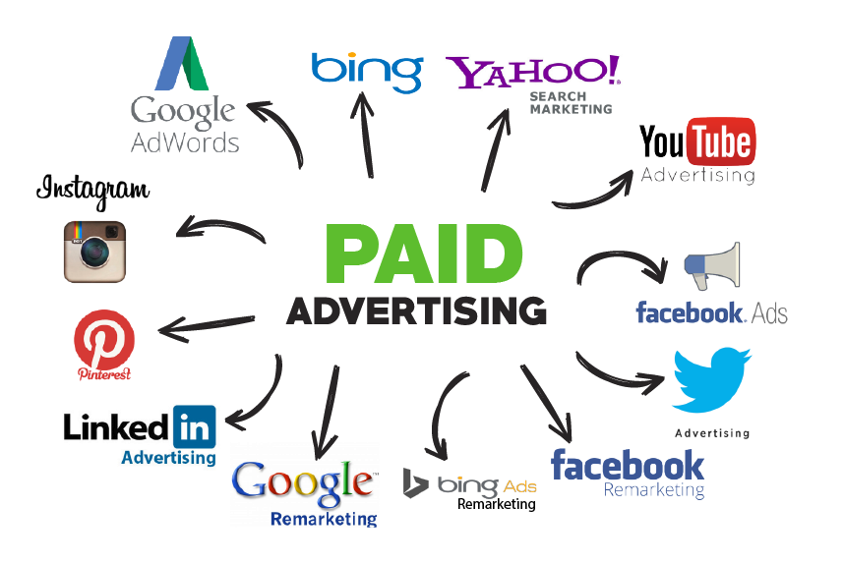
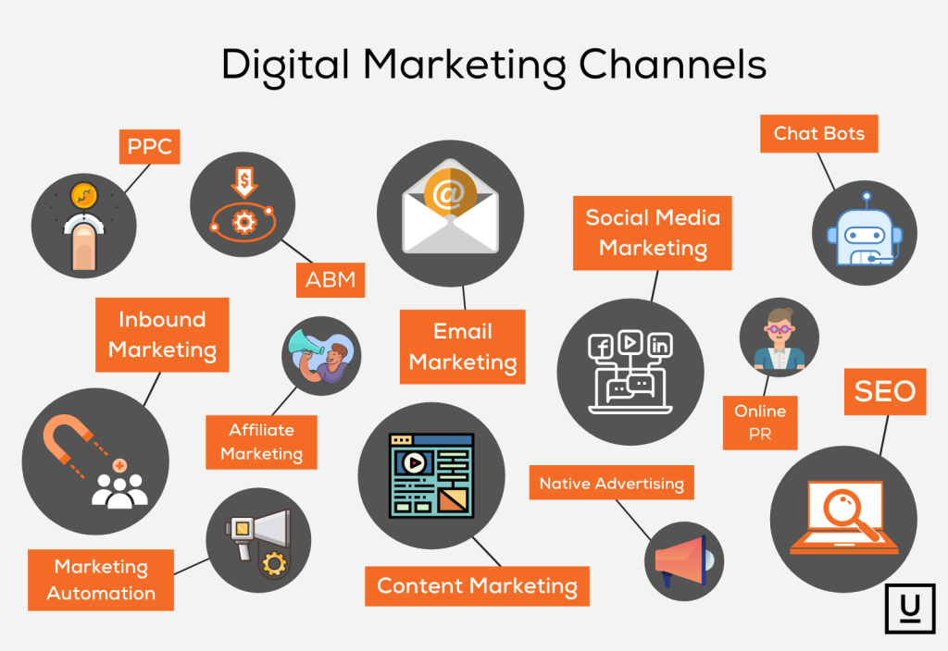
How Much To Spend on Digital Marketing?
What marketing channels should companies focus on?
How many “conversions” (sales) should we expect from specific budgets.

Slide 4
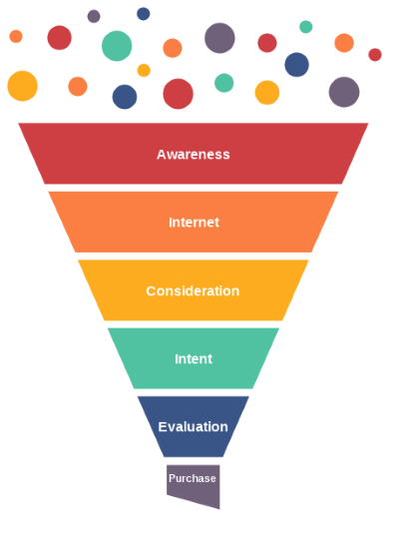

Industry Importance
Budget allocation
Choose high performing channels
Increase overall sales of the business

Slide 5
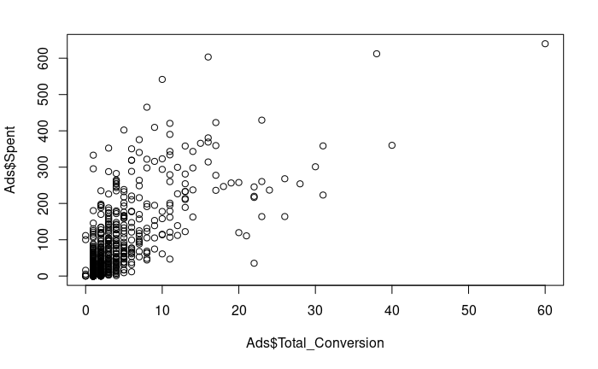
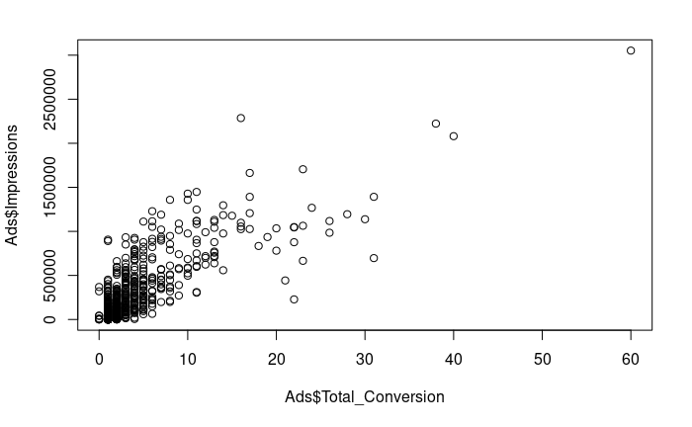
Methods & Results
SVM Model
Stepwise Model
KNN Model
Accuracy: 0.7081

Slide 6
Thank You!

